Slide 1

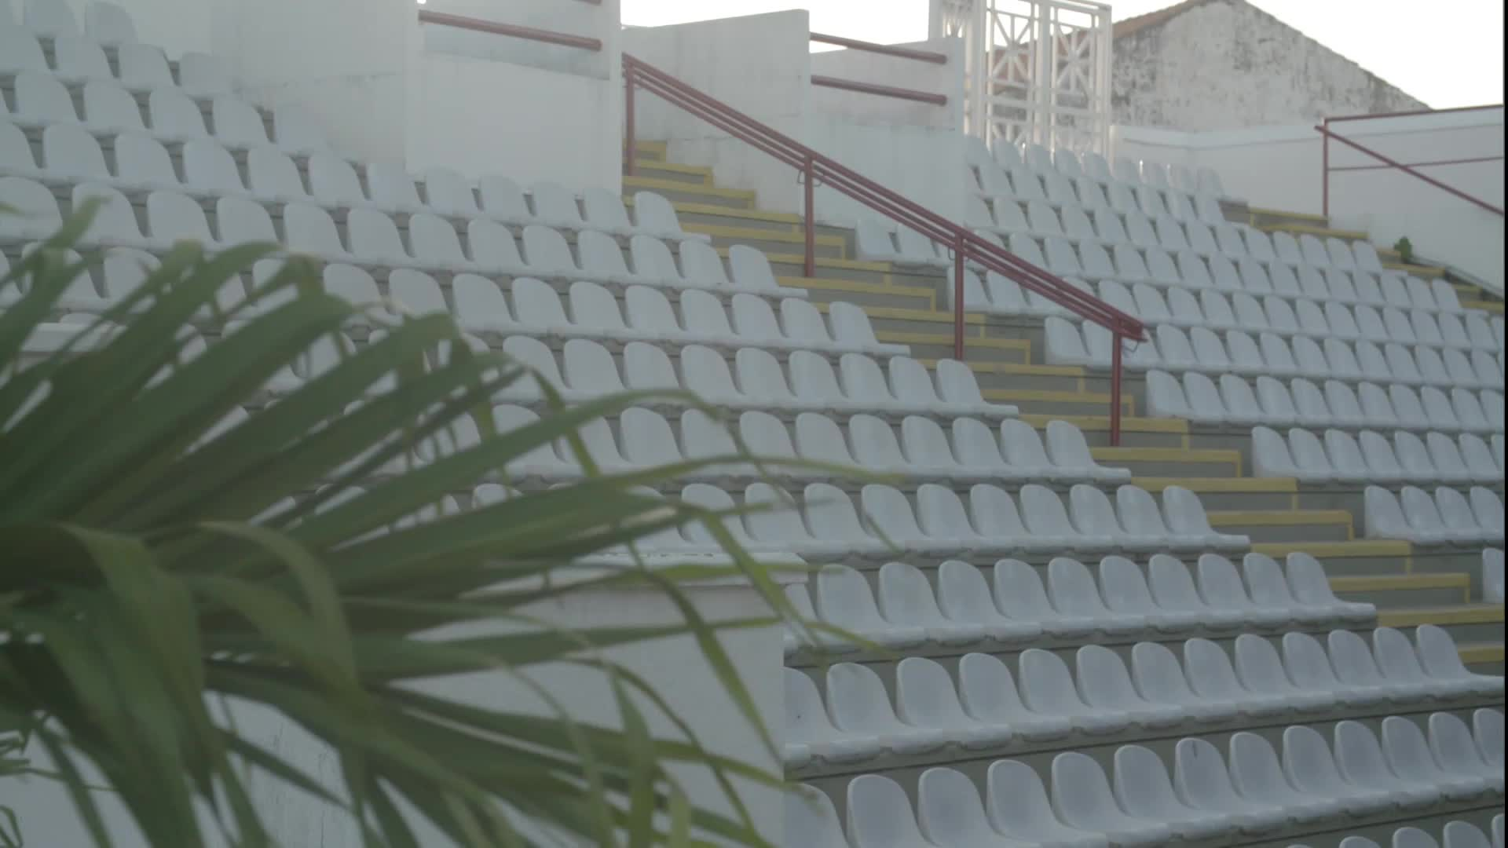
PROVIDE INSIGHTS FOR TELENGANA GOVERNMENT TOURISM DEPARTMENT
Presented by:-
TARUN KUMAR YADAV
Data analyst

Slide 2
Project overview
The Telengana government tourism department is promoting and developing the tourism sector in Telengana (a state of Bharat). The main objective of this project is Attract tourism and develop infrastructure in Telengana. In this project we will provide useful insights of Telengana tourism dataset.

Slide 3
Preliminary research question and useful insights
Secondary research questions
Recommendations to the telengana government
CONTENTS

Slide 4
1.The top 10 districts that have the highest number of domestic visitors
Districts | visitors
Hyderabad | 83900960
Rajanna Sircilla | 41763276
Warangal (Urban) | 30726603
Yadadri Bhongir | 26893080
Bhadradri Kothagudem | 21600962
Medak | 20542639
Jayashankar Bhoopalpally | 19632865
Mahbubnagar | 17180118
Nirmal | 13315796
Jagtial | 11303514
HIGHLIGHTS:
The district Hyderabad has the highest number of domestic visitors (83.9M) in 2016-2019.
Hyderabad followed by rajanna sircilla and Warangal(urban) in domestic visitors in 2016 to 2019
People visit Hyderabad for various reason for example employment,healthcare,education and tourism

Slide 5
2.Top 3 districts of highest CAGR(compound annual frowth rate) in Telengana
District | 2016 | 2017 | 2018 | 2019 | CAGR
Mancherial | 7802 | 191626 | 398004 | 269820 | 225.8037
Warangal (Rural) | 19400 | 144556 | 302012 | 353500 | 163.1455
Bhadradri Kothagudem | 889030 | 4094317 | 3799878 | 12817737 | 143.3875
CAGR=(BB/EB​)^(1/n)−1
EB=Ending balance
BB=Beginning balance
n=Number of years​
The compound annual growth rate (CAGR) is the annualized average rate of revenue growth between two given years
It is used to calculate and determine returns for anything that can rise or fall in value
Mancherial has the highest CAGR followed by Warangal(rural) and bhadradri kothagudem in the period of 2016 to 2019

Slide 6
3.Bottom 3 districts of lowest CAGR of visitors between 2016 to 2019
district | 2016 | 2017 | 2018 | 2019 | CAGR
Karimnagar | 9167468 | 123976 | 93448 | 77491 | -79.6296
Nalgonda | 5858461 | 241916 | 160638 | 140918 | -71.1335
Warangal (Urban) | 25789934 | 1422632 | 1725178 | 1797680 | -58.8452
Bottom 3 districts of lowest CAGR are given above as you can see the lowest CAGR is of karmnagar district of Telengana and it is followed by Nalgonda district
A negative CAGR indicates losses over times rather than gains
The reason of negative CAGR could be crime,poor infrsstructure and lack of transport system to a particular district

Slide 7
4.The peak and low season months for Hyderabad on the data from 2016 to 2019 for Hyderabad district
city | January | February | March | April | May | June | July | August | September | October | November | December
Hyderabad | 6558551 | 5118208 | 5303984 | 6187334 | 6109590 | 16965307 | 5633143 | 5834736 | 5406363 | 6650351 | 5719659 | 9458632
Peak season- June and December
Highest visitors are in these 2 months because of summer vacation in June and winter vacations in december
Low season- feb,march,august and September

Slide 8
The top & bottom 3 districts with high domestic to foreign tourist ratio
district | domestic visitors | foreign visitors | d/f ratio
Nirmal | 13315796 | 2 | 6.7M
Jangaon | 826280 | 2 | .4M
Adilabad | 7321575 | 32 | .2M
district | domestic visitors | foreign visitors | d/f ratio
Hyderabad | 83900960 | 1044898 | 80.295837
Warangal (Rural) | 819162 | 306 | 2677
Mulugu | 1819800 | 575 | 3164.8696

Slide 9
Secondary research based question:( need to do research and get additional data
List the top & bottom 5 districts based on ‘population to tourist footfall ratio*’ ratio in 2019?
What will be the projected number of domestic and foreign tourists in Hyderabad in 2025 based on the growth rate from previous years?
Estimate the projected revenue for Hyderabad in 2025 based on average spend per tourist ?

Slide 10
List the top & bottom 5 districts based on ‘population to tourist footfall ratio*’ ratio in 2019?
district | domestic visitors | foreign visitors | population | total visitor/population
Nalgonda | 6401933 | 0 | 41752 | 153.3324
Rajanna Sircilla | 41763276 | 0 | 552037 | 75.65304
Yadadri Bhongir | 26893080 | 0 | 739448 | 36.36913
Warangal (Urban) | 30726603 | 8821 | 1080858 | 28.43614
Jayashankar Bhoopalpally | 19632865 | 1252 | 711434 | 27.59795
district | domestic visitors | foreign visitors | population | total visitor/population
Kamareddy | 1773 | 0 | 972625 | 0.001823
Peddapalli | 56977 | 0 | 795332 | 0.071639
Nizamabad | 116147 | 5 | 1571022 | 0.073934
Komaram Bheem Asifabad | 92734 | 0 | 515812 | 0.179783
Narayanapet | 389250 | 5 | 1618416 | 0.240516
Population of tourist footfall ratio is measure of how many visitors a district receives in comparison to its population. Population footfall ration is calculated by ratio of the total number of visitor and the total number of its population in a given year. A higher ratio is a good sign for particular district economy.

Slide 11
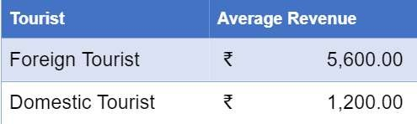
Estimate the projected revenue of Hyderabad in 2025 based on average spend of tourist
year | Sum of domestic visitors | Sum of foreign visitor | projected revenue domestic | projected revenue for foreign
2016 | 23394705 | 163631 | 28.1 | 0.92
2017 | 27160242 | 247179 | 32.6 | 1.38
2018 | 19543651 | 314788 | 23.5 | 1.76
2019 | 13802362 | 319300 | 16.6 | 1.79
2020 | 11638152 | 394878.5 | 14 | 2.21
2021 | 9813289 | 430939 | 11.8 | 2.41
2022 | 8274566 | 470984.3 | 9.9 | 2.64
2023 | 6977114 | 526803.8 | 8.4 | 2.95
2024 | 5883102 | 564856.6 | 7.1 | 3.16
2025 | 4960632 | 612789 | 6 | 3.43
Projected revenue for Hyderabad in the year of 2025 is
For domestic visitors = 4 .96 million
For foreign visitors = 6.127 lakh

Slide 12
Projected population for Hyderabad in the year of 2025
year | Sum of dromestic visitors | Sum of foreign0visitors
2016 | 23394705 | 163631
2017 | 27160242 | 247179
2018 | 19543651 | 314788
2019 | 13802362 | 319300
2020 | 11638152 | 394878.5
2021 | 9813289 | 430939
2022 | 8274566 | 470984.25
2023 | 6977114 | 526803.75
2024 | 5883102 | 564856.63
2025 | 4960632 | 612789

Slide 13
Which district has the highest potential of tourism growth and what action telengana government can take?
Action of government to increase tourism
Creation of world class tourism related infrastructure
Control the crime in major district
Ease of doing business
Skill development

Slide 14

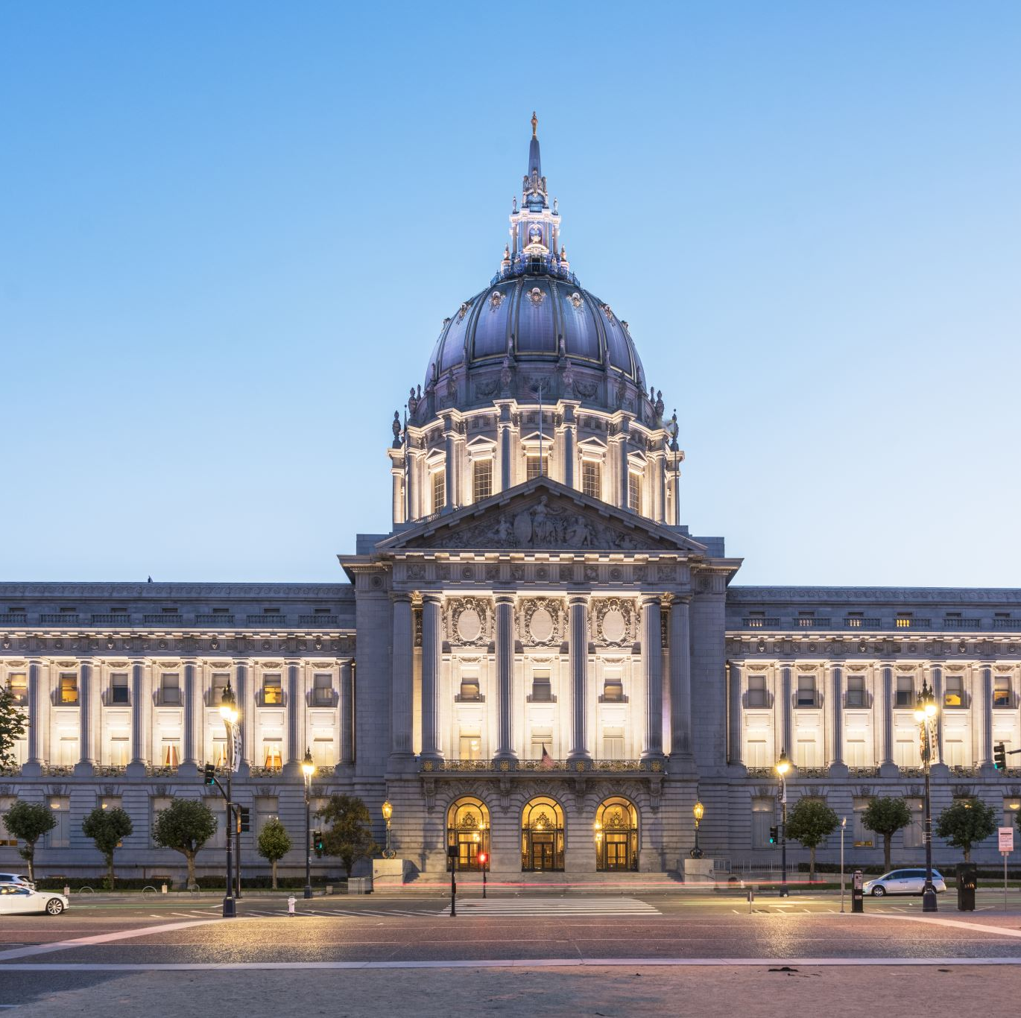
Cutural / Corporate Events to boost tourism
What kind of events the government can conduct?
Which month(s)?
Which districts?

Slide 15
What kind of events the government can conduct?
Competition on Documentations
India Evenings & Road shows
Event to promote local culture and post online
Cleaning competition
Fair and festivals

Slide 16
Which months best suited for tourism
Telangana has the architecture, in the form of mosques,tample,park mausoleums, monuments and palaces. In the winter temperature is suitable around 15-27 degree Celsius
The winter months in telengana is November to February that is the best months for individuals for travel. Telangana is mostly warm through the year except for a couple of months in winters. Most tourists visit Telangana during October to March.
Events and fair can be conduct in the winter season to attract tourism and according to the data the thourism activities are more in the month of september to february
Travel Seasons | Min/Max Temperature | Season
November - February | 15-27°C | Pleasant
March - June | 24-45°C | Warm
July - September | 21-35°C | Moderate-high rainfall

Slide 17


Whict districts to be given more importance for developing tourism
Telangana, a vibrant state in southern India, is known for its rich history, diverse culture, and stunning landscapes and also for its good cuisine.
Here are some best tourism destinations in telengana
Hyderabad- Hyderabad is the capital of telengana here are some best places in hyderabad
Charminar
Golconda Fort
Qutb Shahi Tombs
Ramoji Film City
Warangal- Warangal is known for good tample,fort,lake and its landscape
Warangal Fort
Thousand Pillar Temple
Bhadrakali Temple
Adilabad- Adilabad is known for forest range and tribal culture
Kala Ashram.
Basar Saraswathi Temple
Kadam dam
Khammam- Khammam is known for its historical significance and natural beauty:

Slide 18

THANK YOU

